Slide 1

International Tourism
How inbound tourists & tourism
receipts correlate to GDP

Slide 2
Background:
According to Dorian from UPSALLA Univeristy: the tourism sector has been constantly evolving and expanding. As a result, it has become an important part of the economies of many countries, creating many jobs and contributing substantially to the states’ gross domestic product. The significance of tourism is therefore doubtless. Developing this industry would bring a series of positive externalities, leading to a virtuous circle, in which more visitors contribute to the economic development of a region, and a more advanced economy is expected to bring a higher number of tourists through different indirect channels
We were able to use The World Data website to choose which series were relevant to our topic sand create a csv directly from there which made this a great dataset to work with
We broke the dataset down to the years 2016 to 2019 and all worked on each years individually then compared our findings at the end over all 4 years

Slide 3
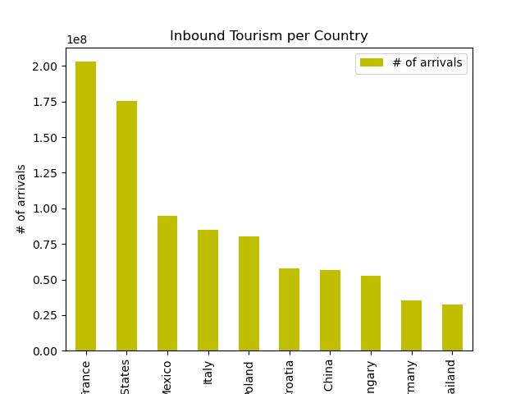
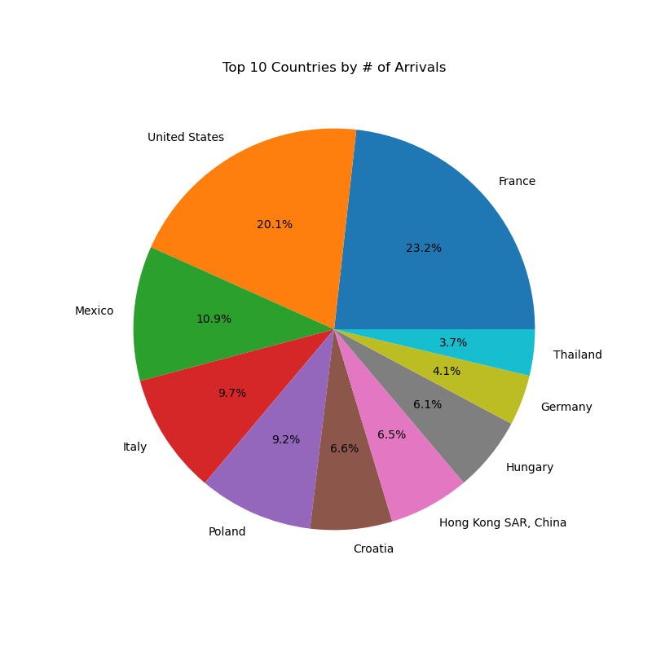
2016 - Which Countries attract the most tourists?
In 2016, France had the most inbound tourists at 203,042,000 million
The US was a close second, and then we see a stark decrease in inbound tourists for the other top 7 countries

Slide 4
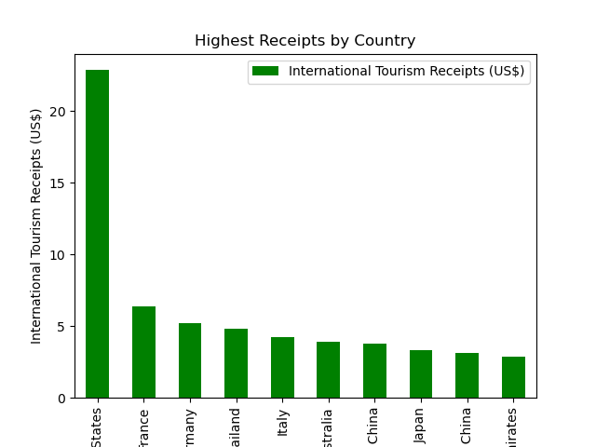
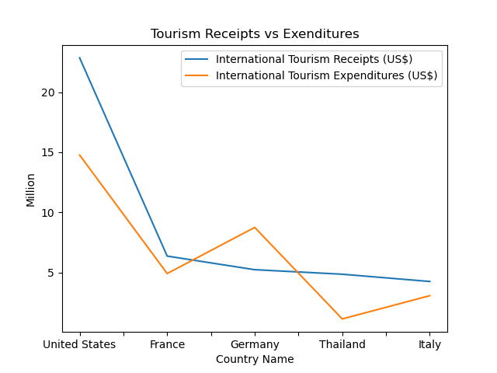
2016 - Which countries had the highest International Tourism Receipts?
The United States has the highest receipts by a landslide at $228,549,000,000
France came in at second with $63,557,000,000 and the following top countries came in close ranging between 3 to 5 trillion each

Slide 5
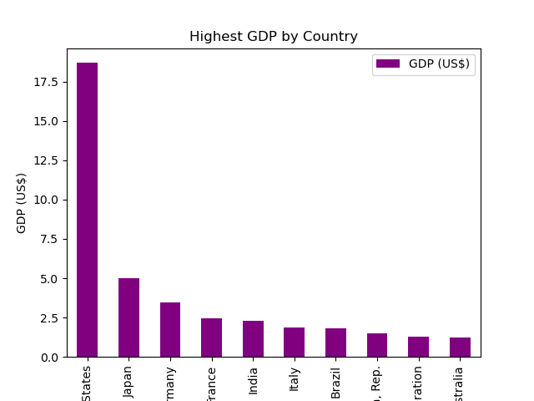
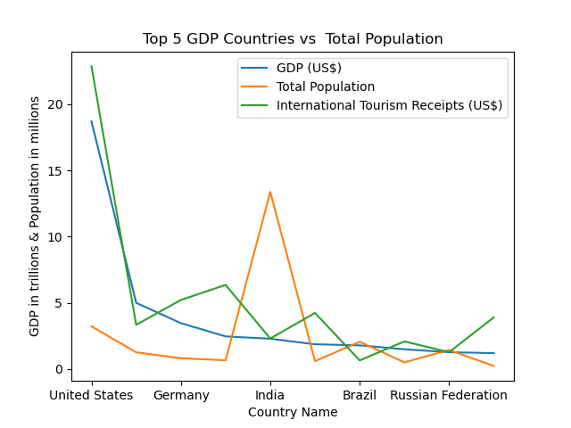
2016 - Which country has the highest GDP?
Similar to receipts, the US again leads in GDP with $18,695,111,000,000 annually
The other top 10 countries all trail far behind with the next highest being Japan at $5 trillion

Slide 6
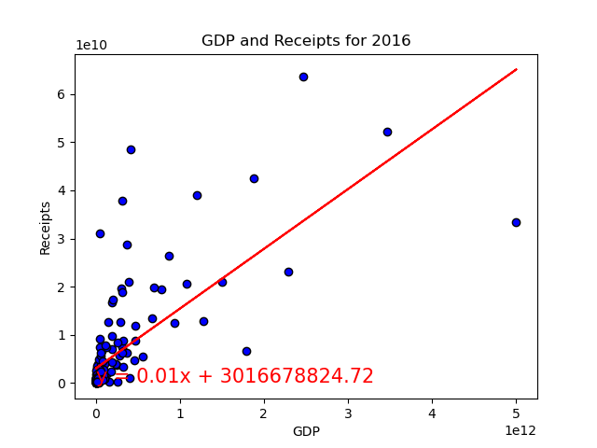
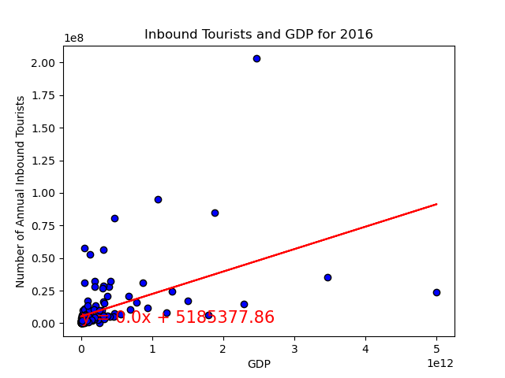
2016 - What’s the correlation?
When outliers (United States) are dropped, the r-value is 0.72.
This shows us there is some correlation between GDP and receipts
The r value here comes out to 0.49 which a fairly low
This tells us that there is a low probability that the amount of inbound tourists correlates to a country’s GDP

Slide 7
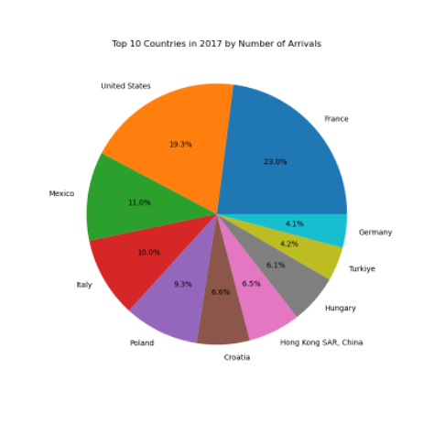
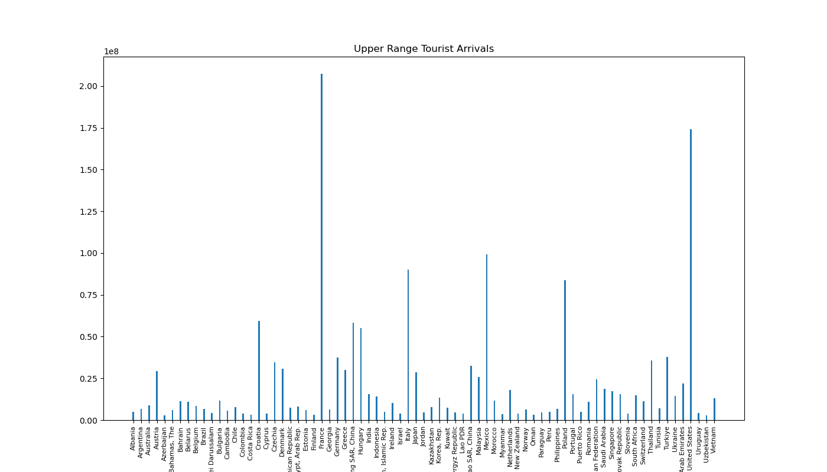
2017 Tourism Analysis
Which countries attract the most tourists?
•In 2017 France had the highest number of inbound tourists with a count of 207,274,000 tourists
•The United States came in second with 174,291,750 annual tourists
•Mexico came in third with 99,349,000 annual tourists

Slide 8
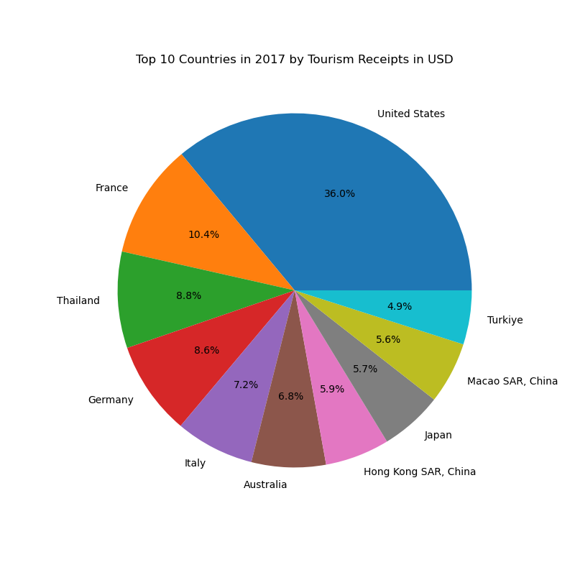
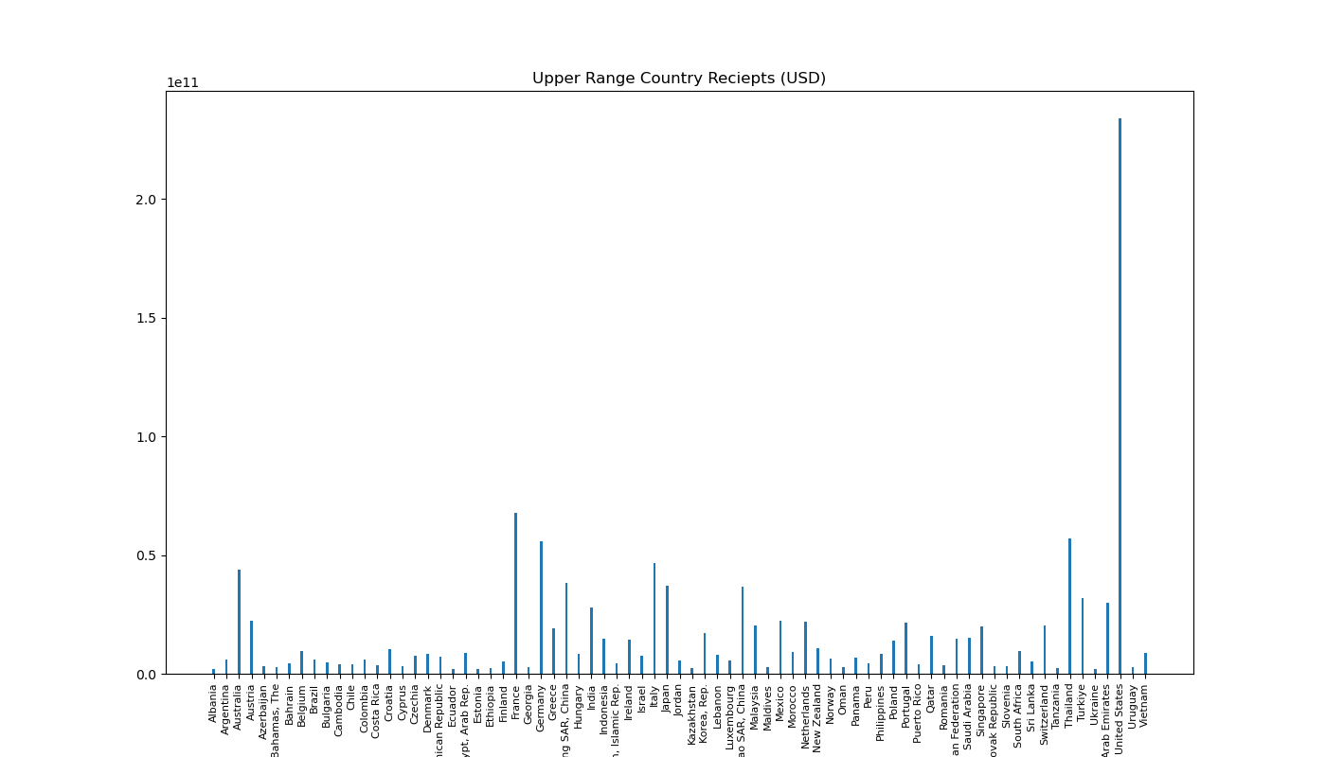
2017 Tourism Analysis
Which countries have the highest receipts from tourism?
The US has the highest with $233,758,000,000 in tourist receipts
France has the second highest with $67,717,000,000 in tourist receipts
Thailand has the third highest with $57,057,000,000 in tourist receipts

Slide 9
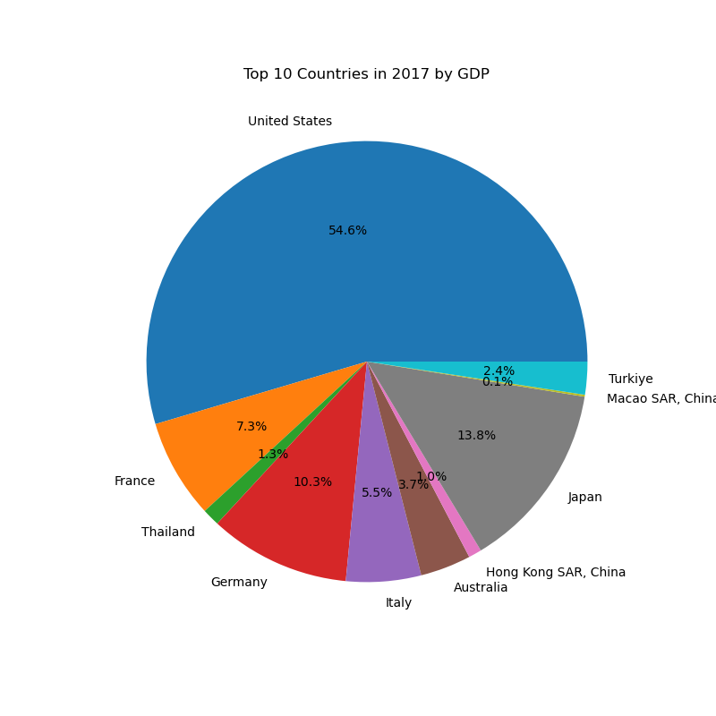
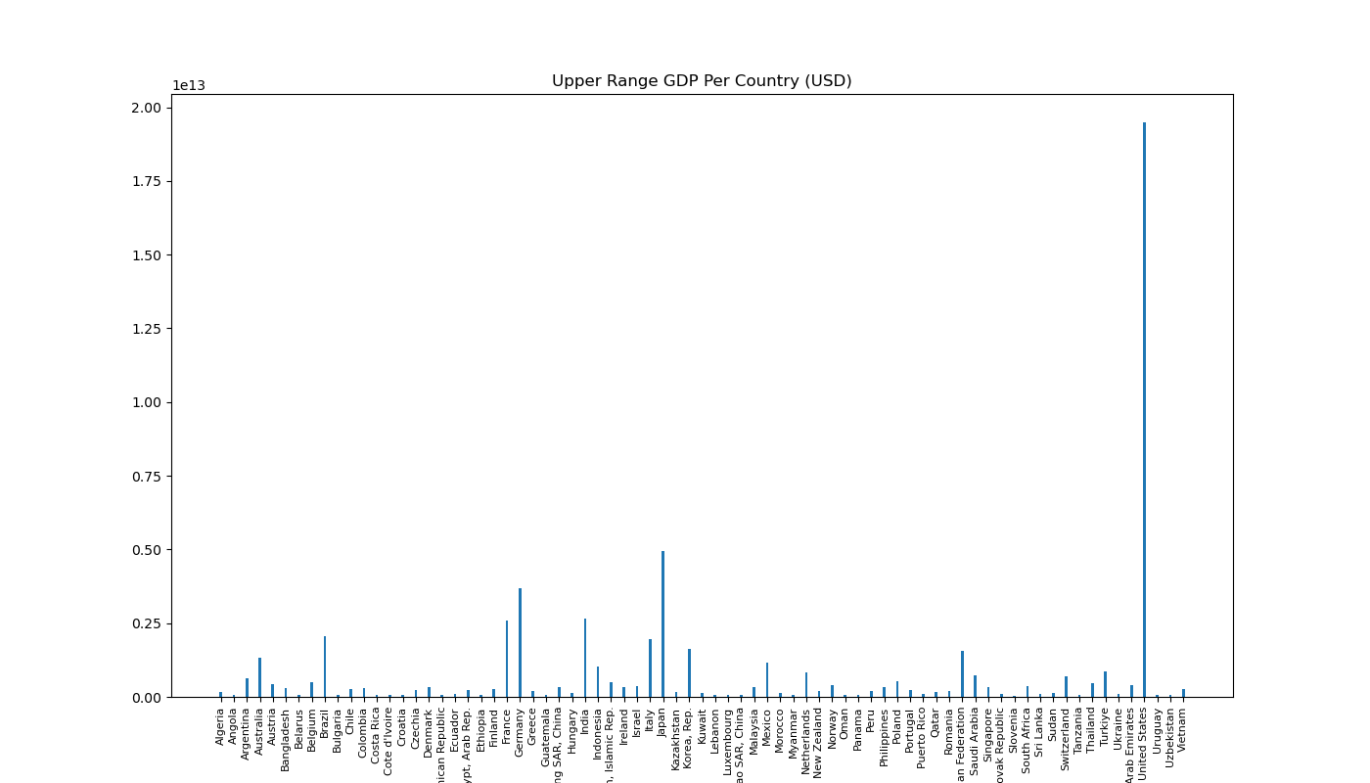
2017 Tourism Analysis
Which Countries have the highest GDP?
The US has the highest GDP with $19,477,336,549,000
France has the second highest GDP with $2,595,151,045,197
Thailand has the third highest GDP with $456,356,812,774

Slide 10
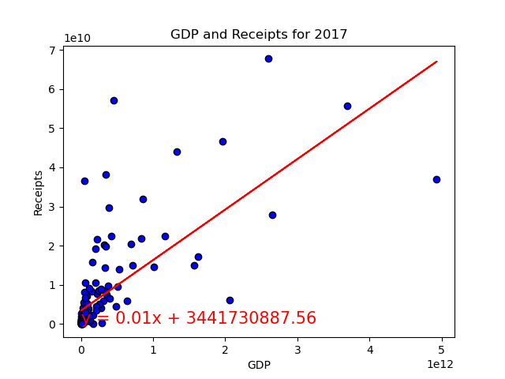
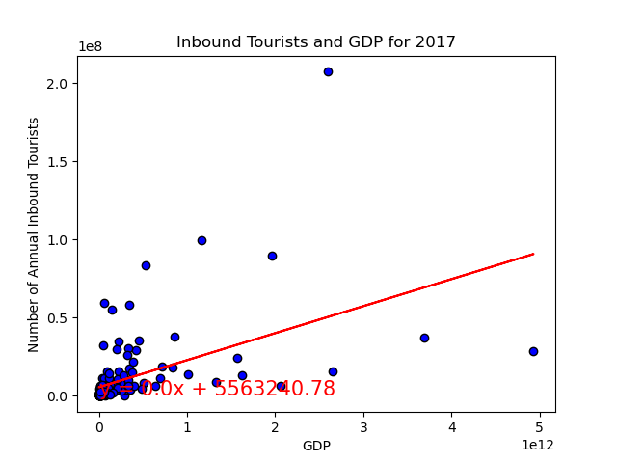
2017 Tourism Analysis
When we remove the US from our correlation the r-value between GDP and tourist receipts comes out to .70. When we add the US our r-value is .90.
When looking at the inbound tourist count and the GDP of a country the r-value comes out to .49

Slide 11
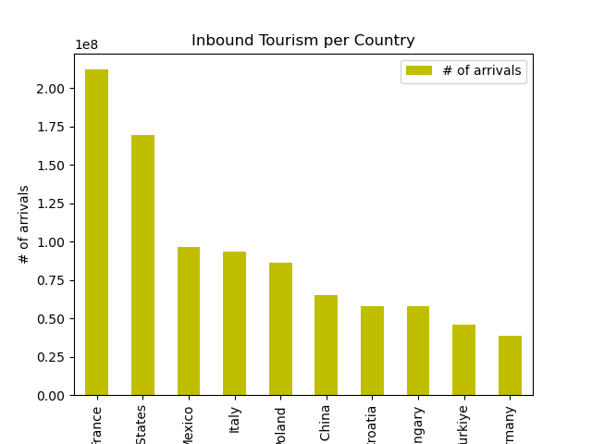
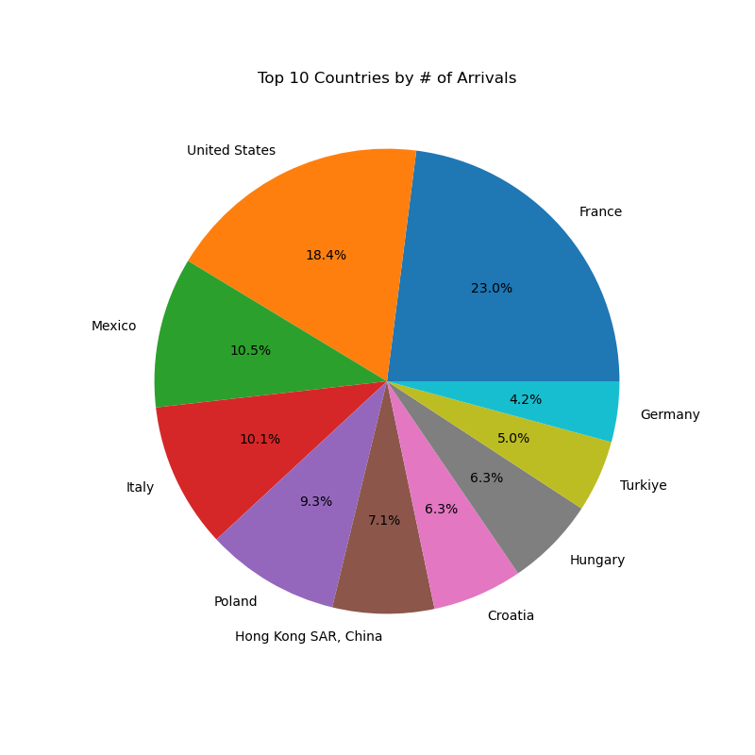
2018 Tourism Analysis
What countries attract the most inbound tourists?
In 2018, France had the most inbound tourists.
This remains true from 2016 and 2017 as well, so clearly France is a popular destination.

Slide 12
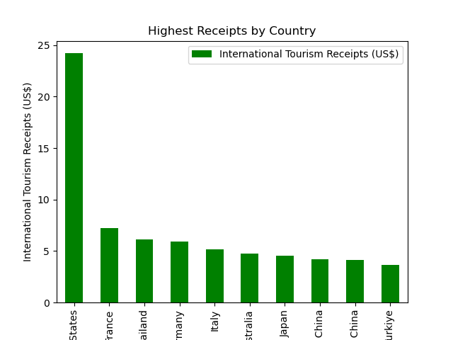
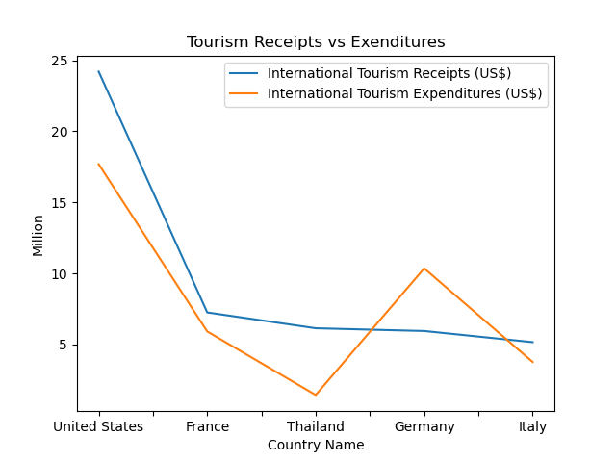
2018 Tourism Analysis
Which countries has the highest international receipts?
The United States had the highest number of tourism receipts beating out every other top country by a large percentage.
We can see that this statistic is also holding true from 2016 & 2017

Slide 13
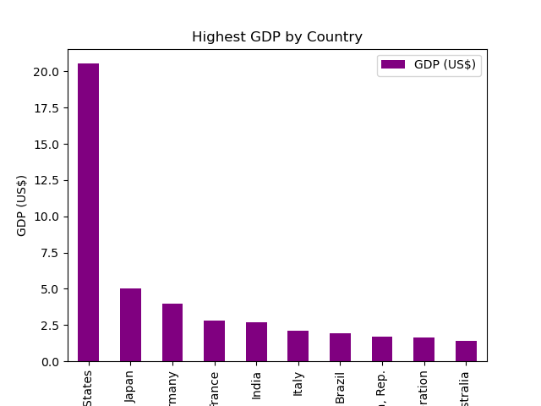
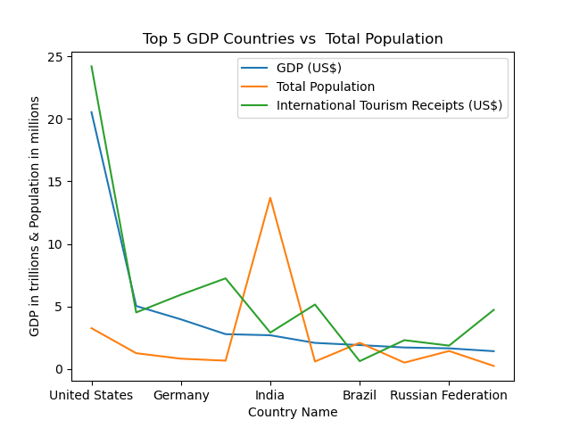
2018 Tourism Analysis
Which country has the highest GDP?
The US had the highest GDP coming in at over 20 trillion dollars
They are highly set apart from the other top 9 countries by 15 trillion or more

Slide 14
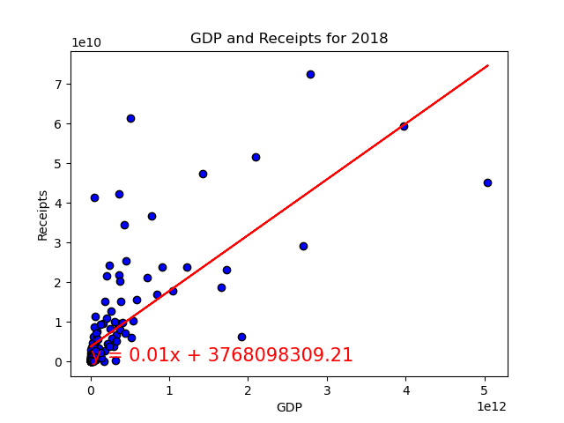
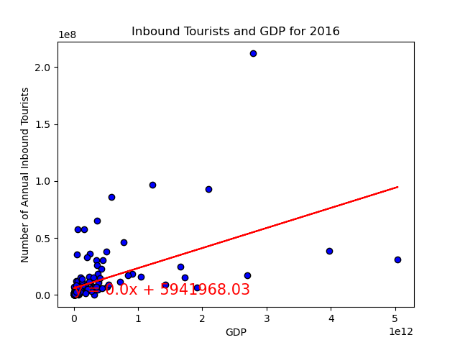
2018 Tourism Analysis
What is the correlation of these data points?
When we remove the US from our correlation the r-value between GDP and tourist receipts comes out to .73
When looking at the inbound tourist count and the GDP of a country the r-value comes out to .51

Slide 15
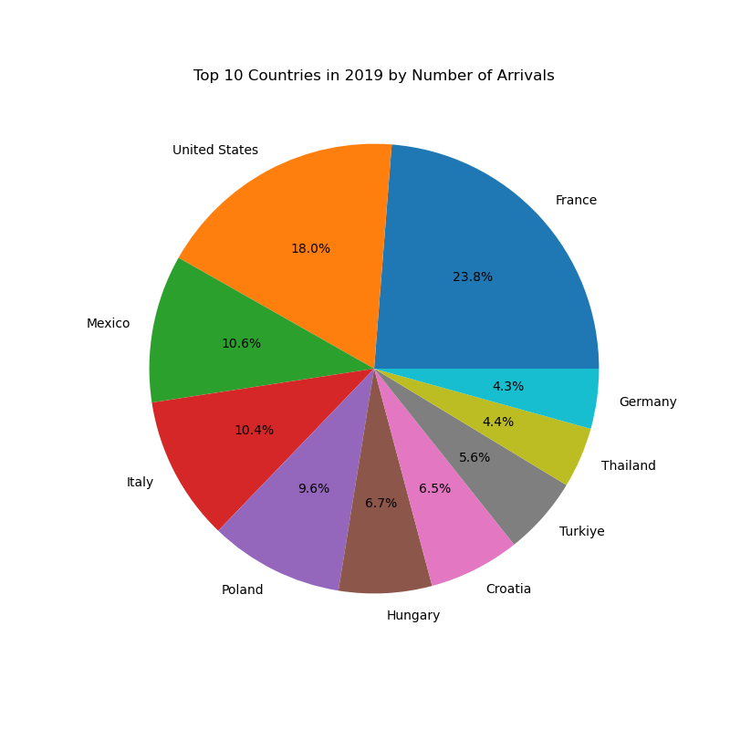
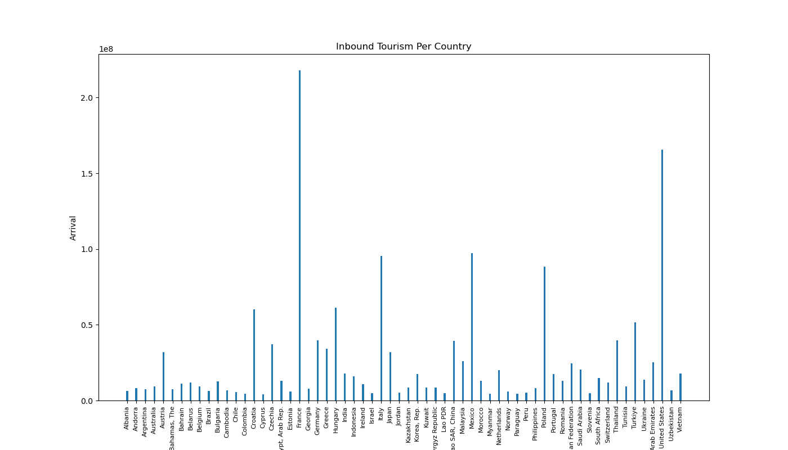
2019 Tourism Analysis by Kelechi Joel
Question 1: What countries attract the most people?
Post sorting data frame contained about 124 countries to be analyzed from our initial dataframe.
In 2019 France attracted the most tourist in 2019 with approximately 217,877,000 tourist arrivals.
The US(165,478,000) came in second place and Mexico(97406000)came in third place.

Slide 16
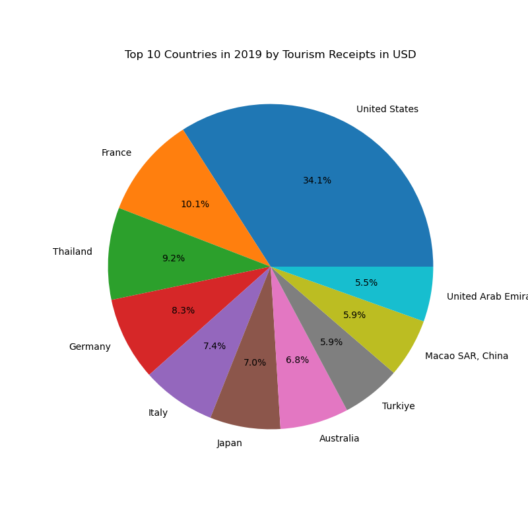
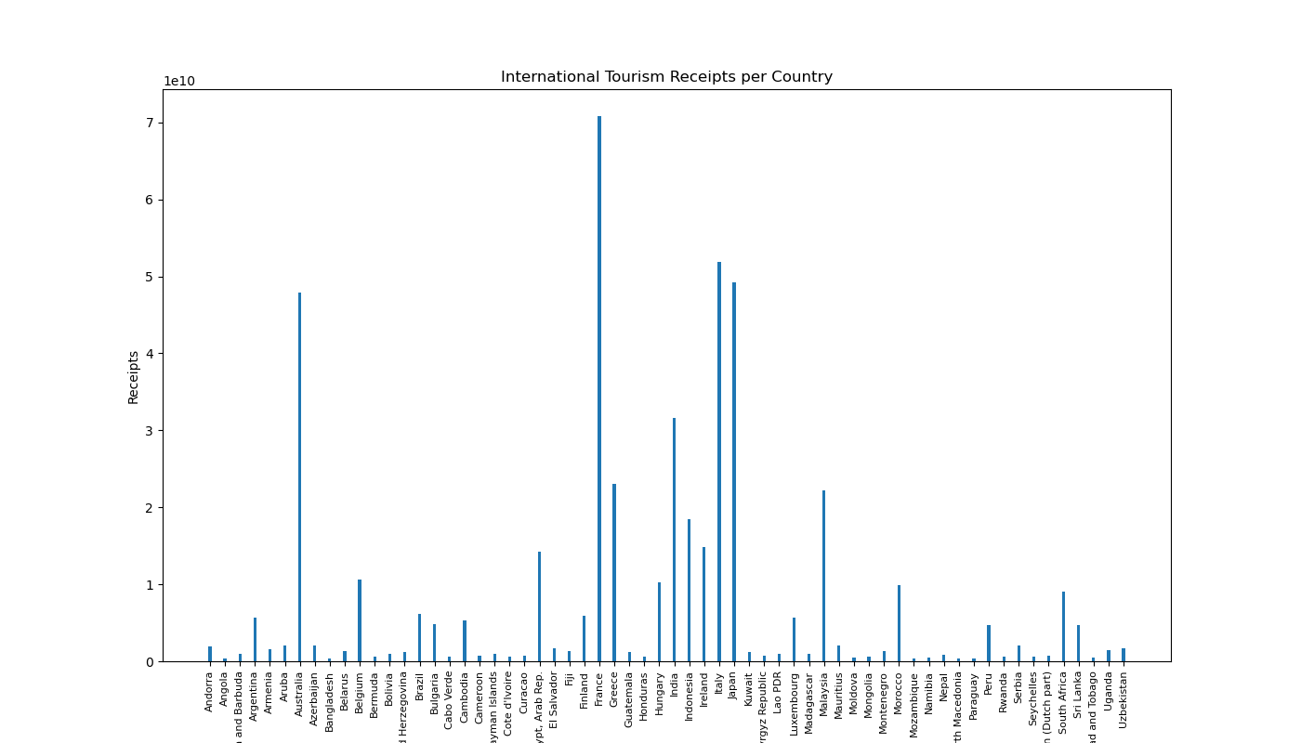
2019 Tourism Analysis by Kelechi Joel
Question 2: which countries has the highest international tourism receipts?
Though France had the most tourist arrival in 2019, the United States had the highest international tourism receipts with a gross amount of about $239,447,000,000.
France came in second with a gross amount of $70,776,000,000.
Surprisingly Thailand came in third with a gross amount of 64,371,000,000

Slide 17
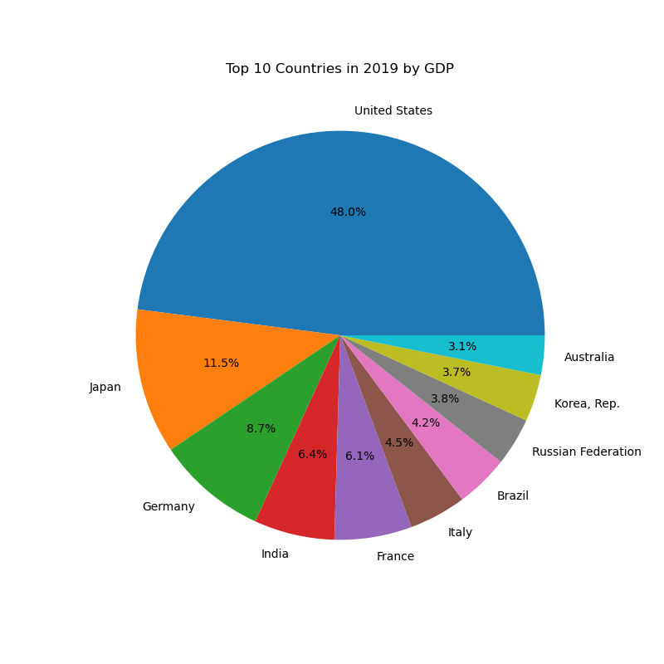
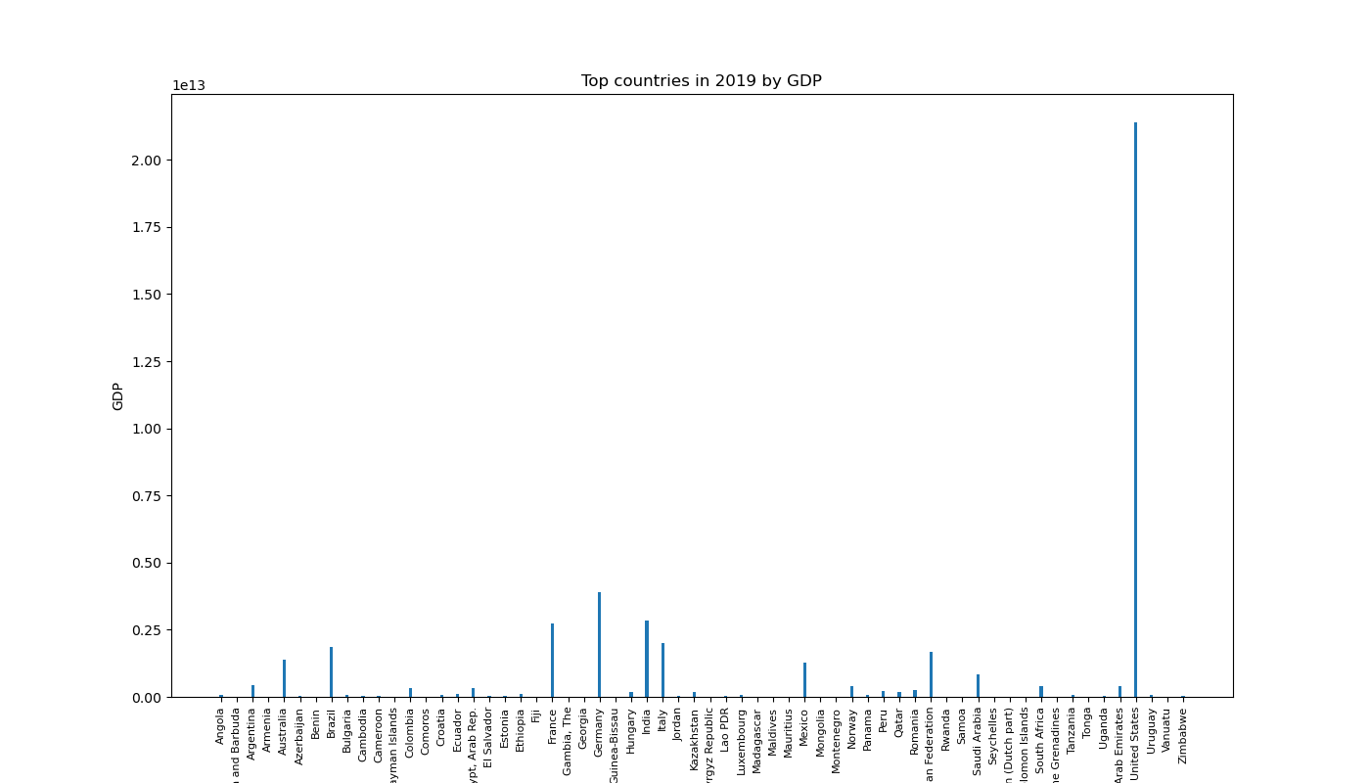
2019 Tourism Analysis by Kelechi Joel
Question 3: Which countries have the highest GDP?
In 2019, the United States had the highest GDP by far from any other country of about $21.83 trillion.
Japan comes in second with about $5.12trillion.
Germany comes in third with about $3.89 trillion.

Slide 18
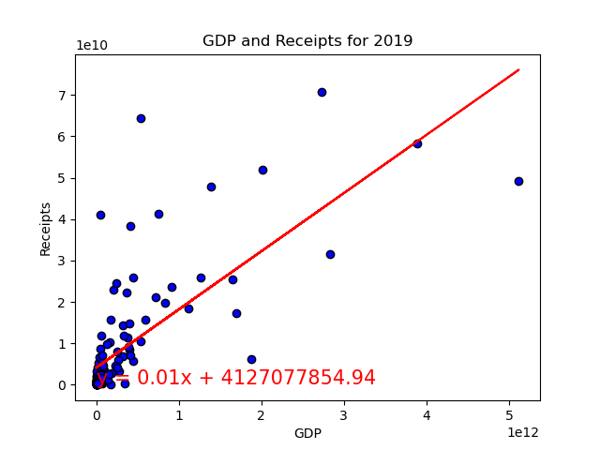
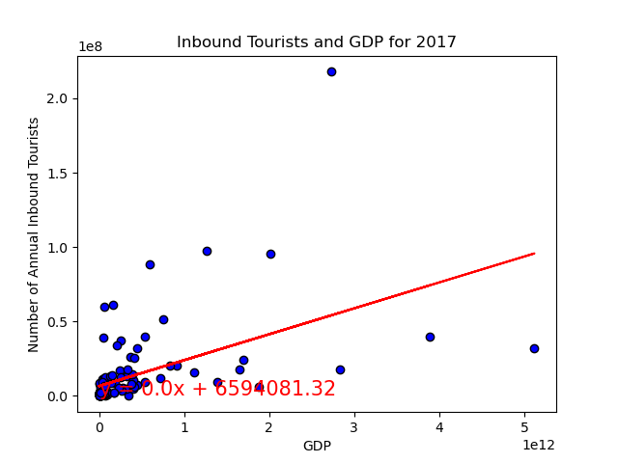
2019 Tourism Analysis by Kelechi Joel
Question 4: What’s the correlation?
To understand how Tourism receipts were dependent on a countries GDP in 2019, we plotted the data set.
The United States was eliminated because it was the outlier in our data frames.
The r-value of this correlation was 0.74, which indicated even without the united states there is a huge correlation on how much tourist spend when it comes with countries with higher gdp.
To understand if number of inbound tourist was dependent on a countries GDP, we plotted the data set.
Again, the united states was eliminated as the outlier so the data acquired can better be understood.
The r-value of this correlation was 0.5. Which signified a weak correlation between a country's GDP and the amount of tourist arriving .

Slide 19
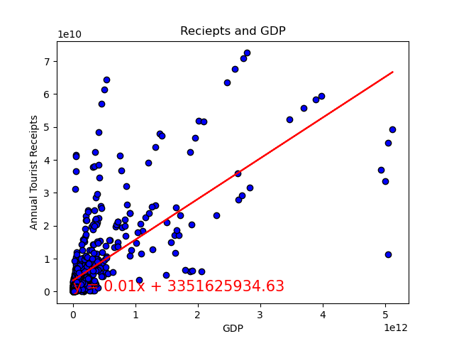
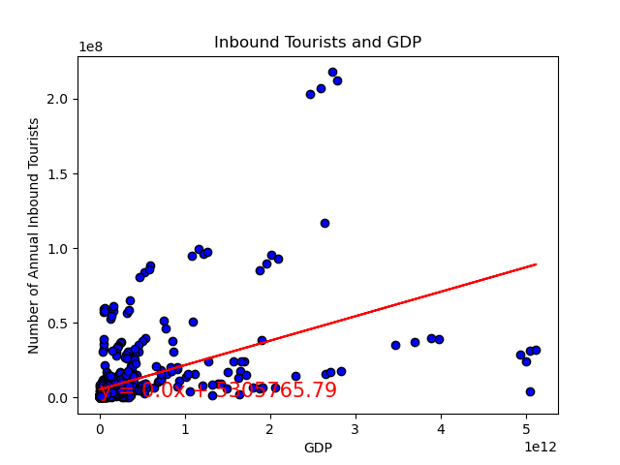
Conclusions & Findings
When looking at our data across all 5 years, we found that there was a strong correlation between Tourism Receipts and GDP and a weak correlation between Inbound Tourists and GDP.
The r value for Receipts and GDP is 0.70 when omitting outliers (the United States). When outliers are included however, the r value is 0.93. These findings stay consistent over what we found in individual years.
The country with the highest inbound tourism year over year was France but the country with the highest GDP year over year was the United States. The United States also has the highest receipts year over year as well and based on our correlation findings, it makes sense that they are the leaders in GDP as well.
We can conclude from the United States alone that the number of inbound tourists does not have the same impact as the number of international tourism receipts.
This helps policy makers in various countries understand the approach needed in improving their tourist models.
In this case it seems policy makers should be more focused on how to improve tourist sites and encourage spending compared to investing in just attracting tourist.

